Slide 1
Simulating sweeps and adaptation in evolution experiments using SLiM, part II
Changyi Xiao & Neda Barghi

Slide 2
Overview
Day1
Detecting selection target
Reconstruct haplotype blocks
Day 2
SLiM simulation
Model Fitting
Drift
statistical methods
(CMH-test
Chisq-test)
Linkage (correlated frequency change)
characterize selection (e.g. selection coefficient)
Model selection
connection between simulation and experiments
summary statistics (e.g. Jaccard index)
Notes:
1.1 detecting selection target
-understand drift, effective population size and how they influence selection
-statical method detecting loci underlying selection based on the allele frequency change
1.2 reconstruct haplotype blocks
-understand linkage
-based on the correlation in allele frequency change between SNPs
-characterize selection at the haplotype scale(allele frequency change trajectories)
2.1 SLiM simulation
-learn two major selection process
-define selection model in SLiM
2.2 model fitting
-connection between simulation and empirical data
-exemplified summary statistics to measure the model fitting

Slide 3
Simulations of E&R Under Neutrality and Selection - SLiM
Neda Barghi & Changyi Xiao

Slide 4
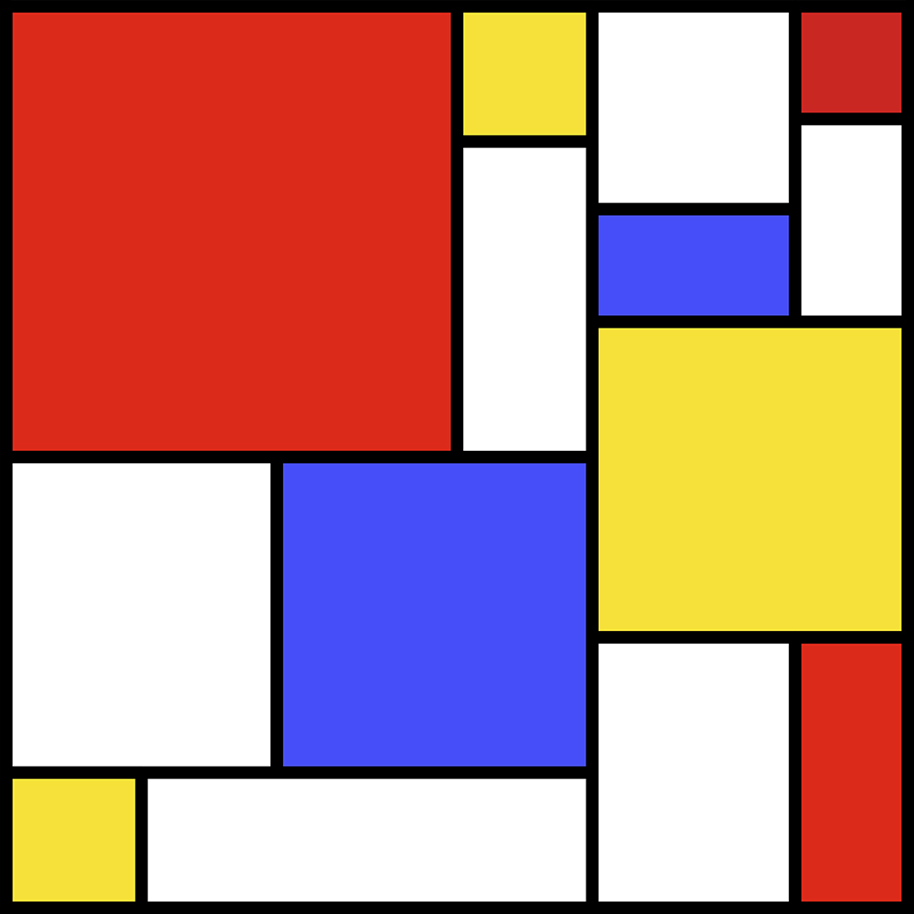
SLiM
forward genetic simulation package
from the Messer Lab at Cornell University

Slide 5
SLiM - Materials
www.messerlab.org/slim/
SLiM Manual
Eidos Manual
Reference Sheets
Workshop (www.benhaller.com/workshops/workshops.html)
Mailing Lists (slim-announce & slim-discuss)

Slide 6
What is SLiM?
Forward genetic simulations
Forward simulation
Works on the genomic level
Individual-based modeling
Fitting empirical population genomic data
Analysing theoretical evolutionary models
Developing statistical methods

Slide 7
Why SLiM?
Open source on GitHub, GPL license
Interactive & graphical (SLiMgui)
Fast
Flexible & customizable with Eidos
Eidos is similar to R in syntax & function names, but ends statements with semicolons and is zero-based
Universally used

Slide 8
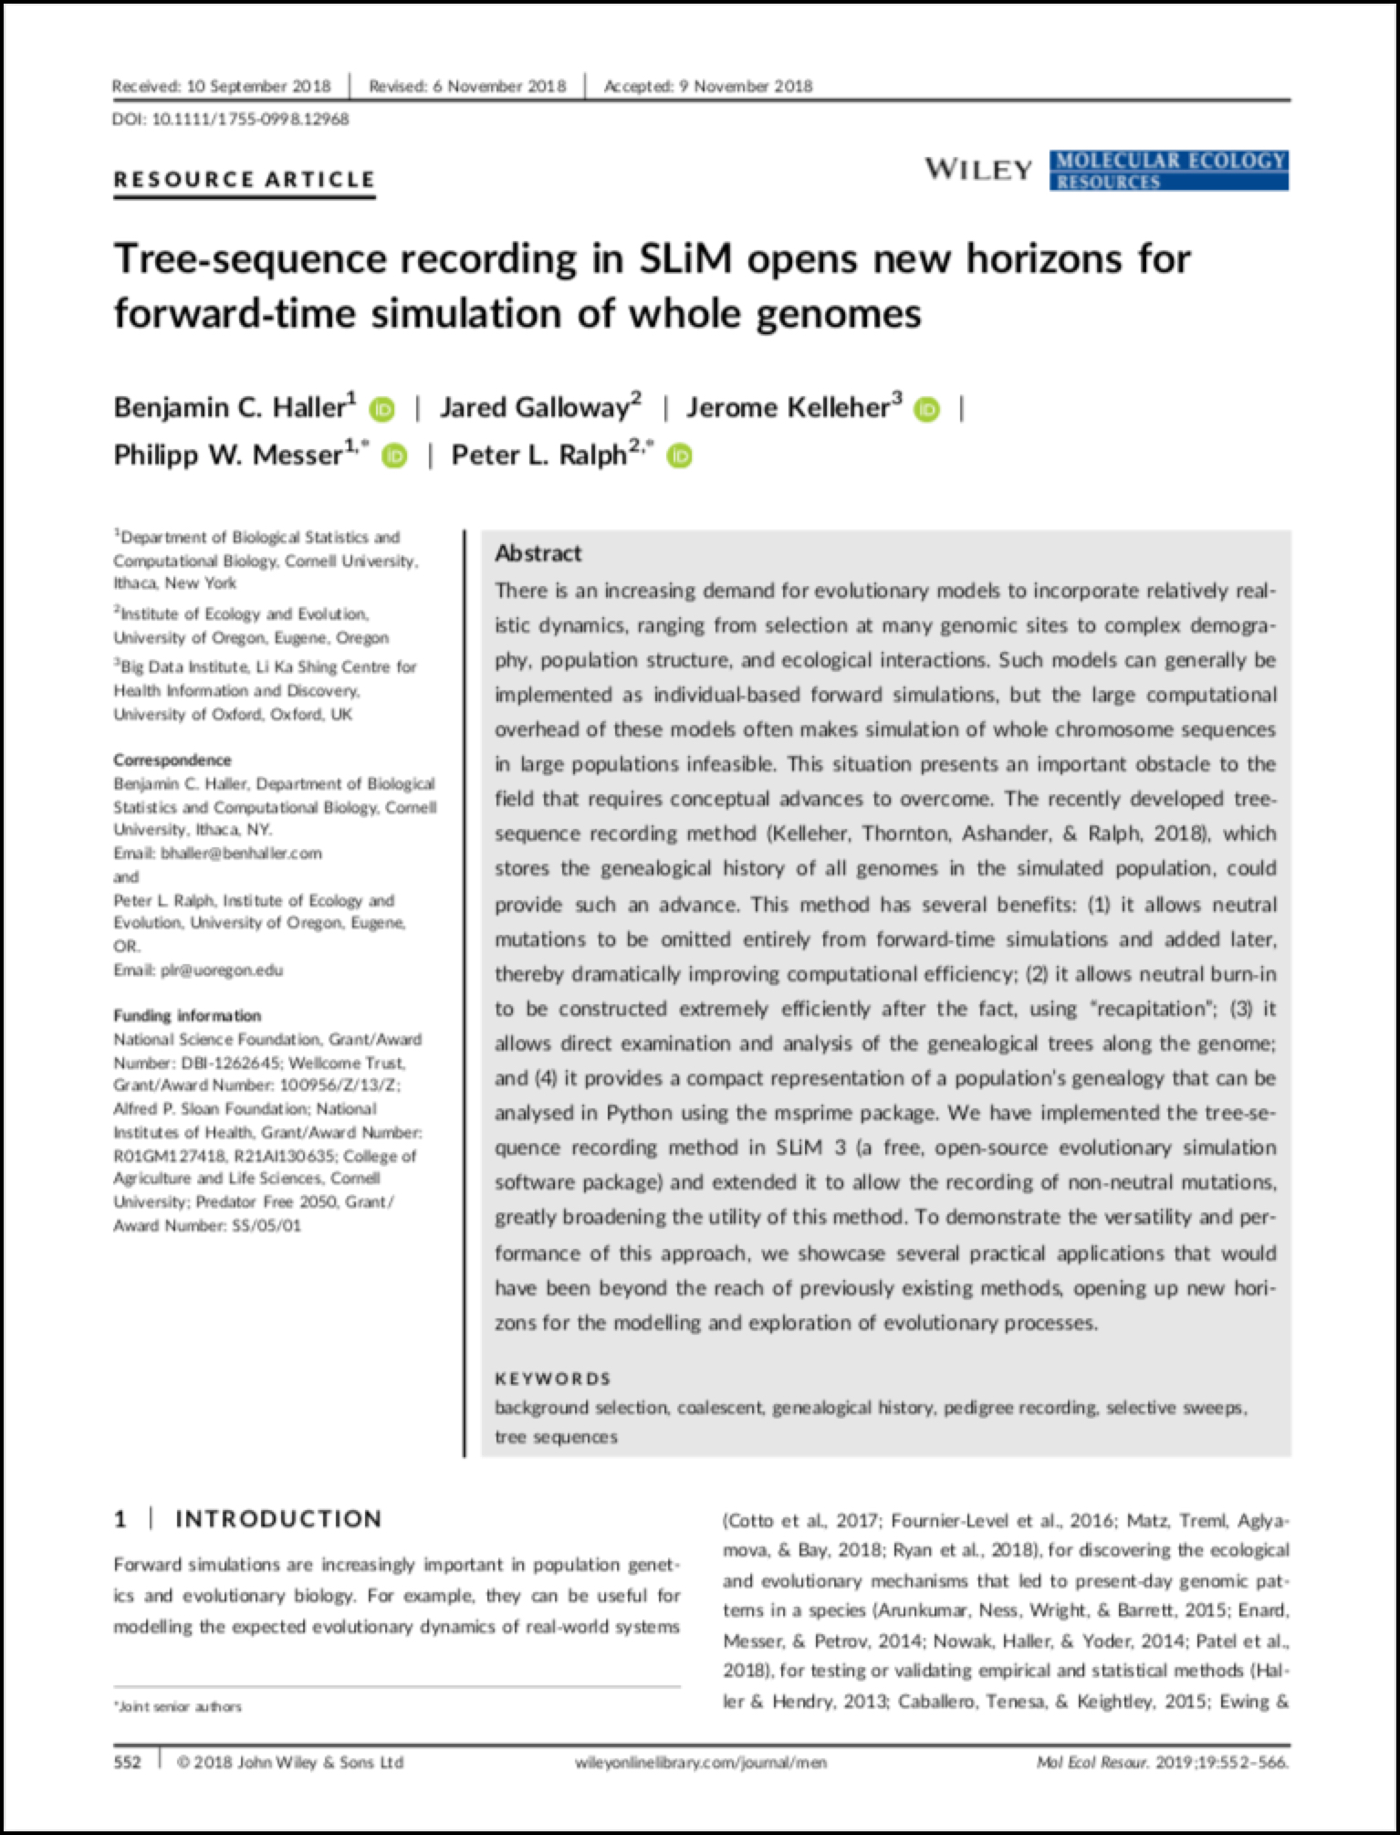
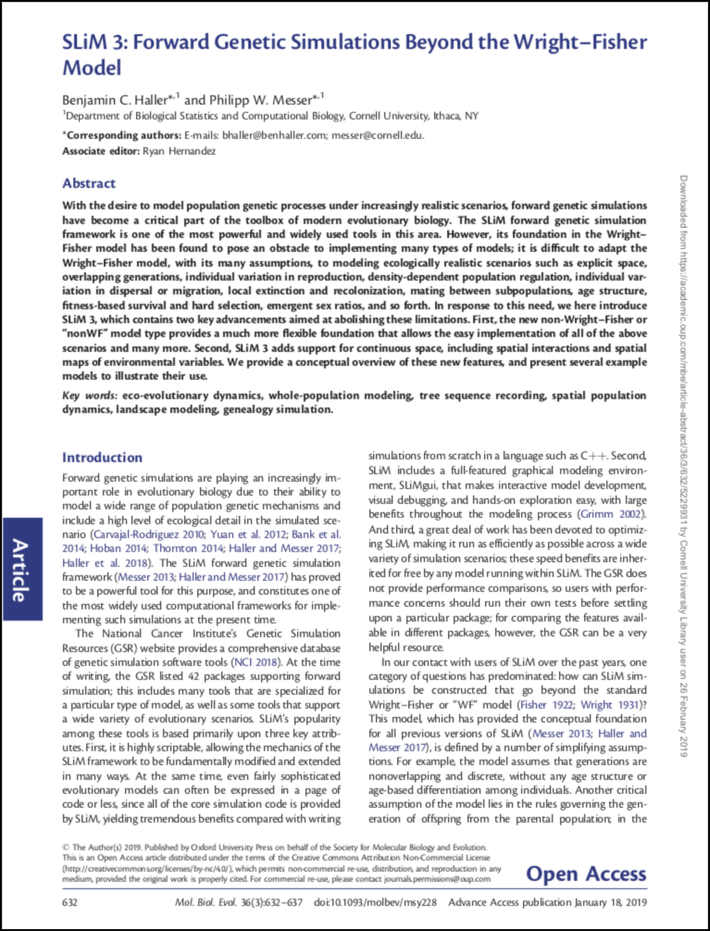
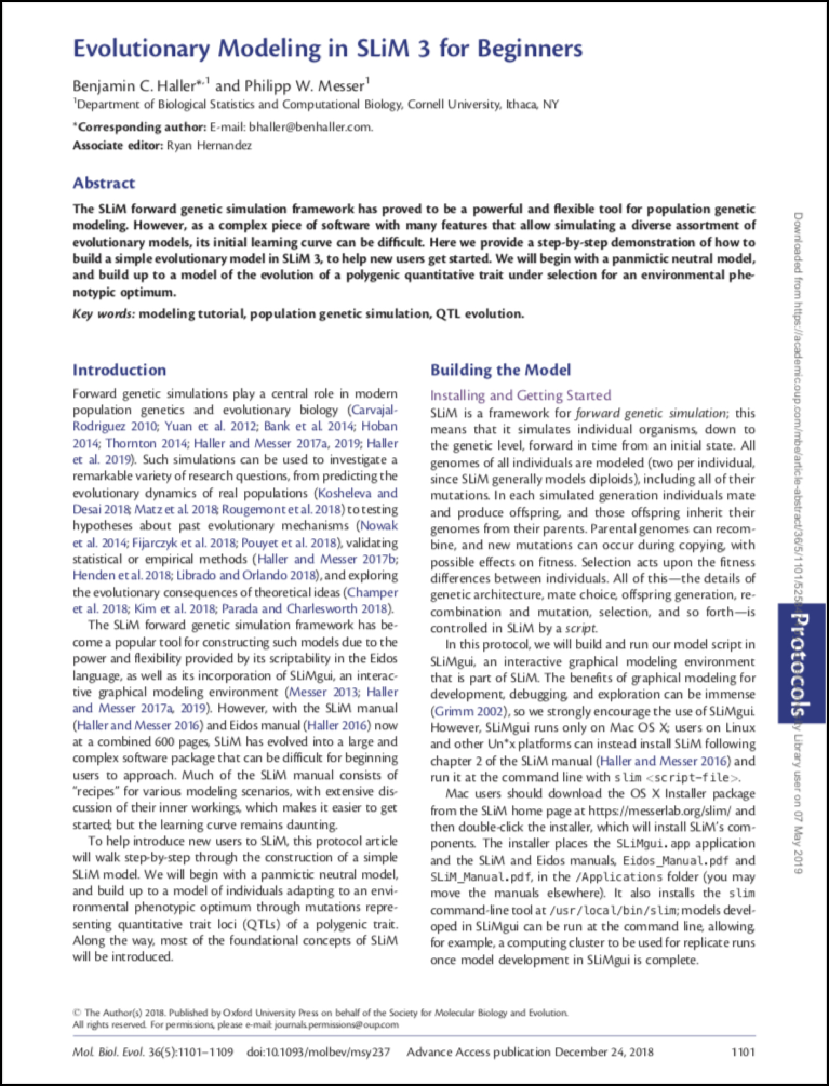
How to use SLiM?
Initial modeling in SLiMgui
SLiM Recipes
Production runs (on a cluster)
Post-run analysis in Eidos, Python, or R
(we use version 4.0.1 of SLiM)

Slide 9
SLiMgui Simulation Window
1. The scripting panel
2. The output panel.
3. The population view.
4. The individual view.
5. The tick controls.
6. The chromosome view.
Figure from the SLiM-Manual.
Notes:
show other stuff directly in SLiMgui

Slide 10
Five selection models
Selective sweep + LE
Selective sweep + LD
Redundancy
QTL + LE
QTL + LD

Slide 11
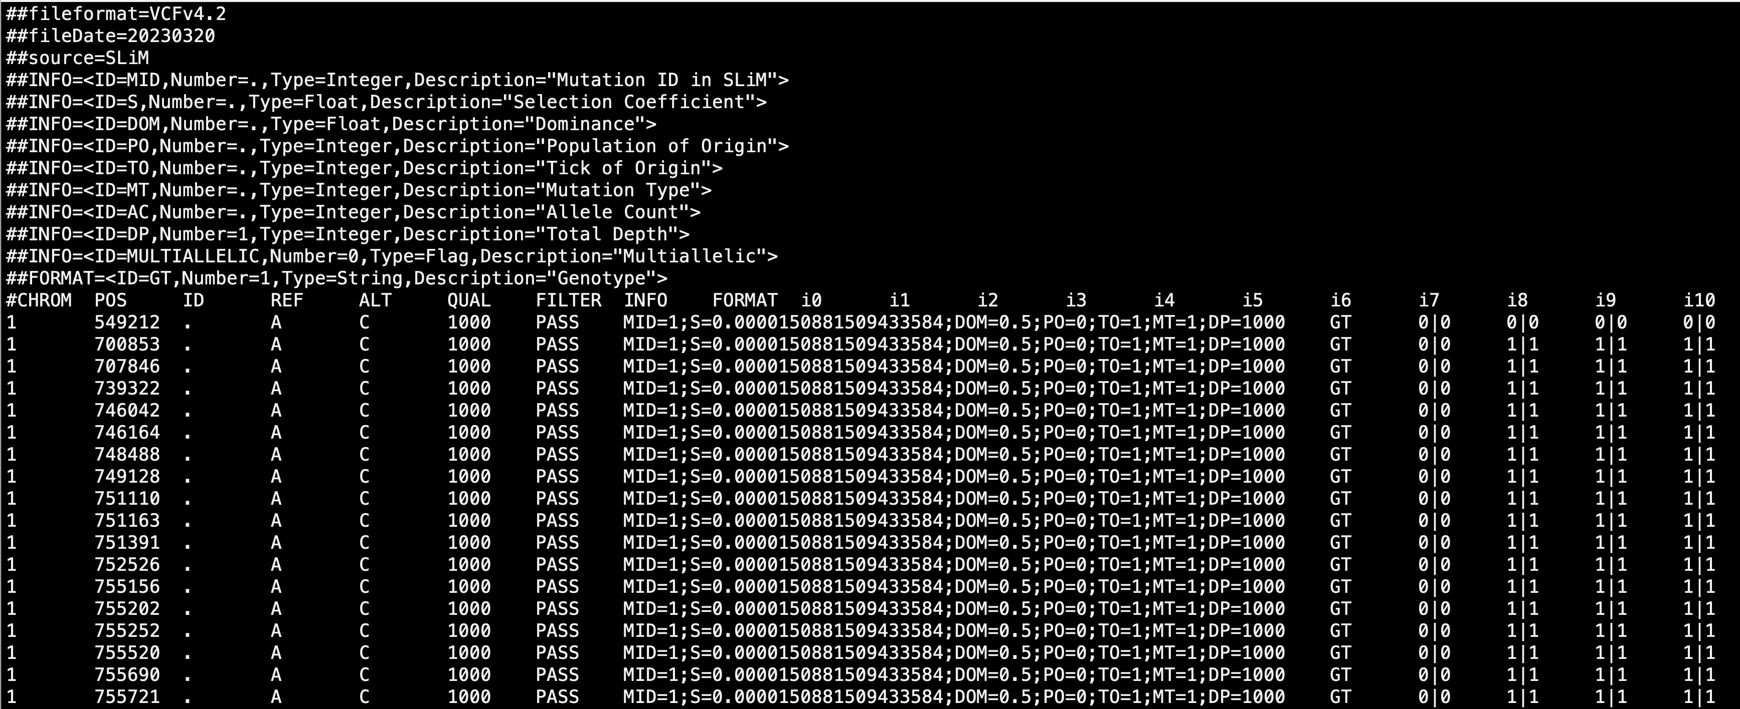
The haplotype data (input)
189 Iso-female lines
Crossing with the reference strain(M252)
Individual sequencing
Vcf format

Slide 12
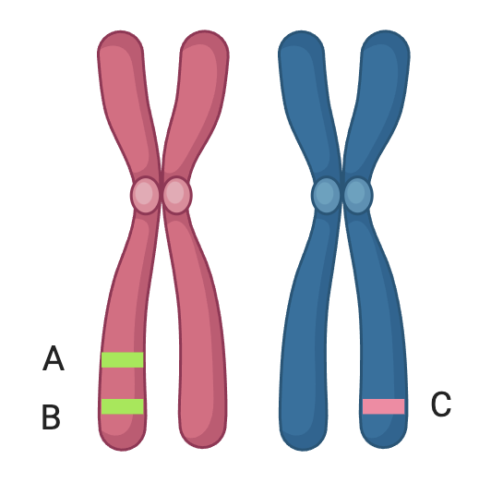
Linkage in the simulation
A,B inherited together (unless recombination happen)
Inheritance of C is independent of A and B
Linkage equilibrium
Each SNPs is independent of each other
Linkage disequilibrium:
SNPs located on the limited number of chromosome
recombination map of D. simulans

Slide 13
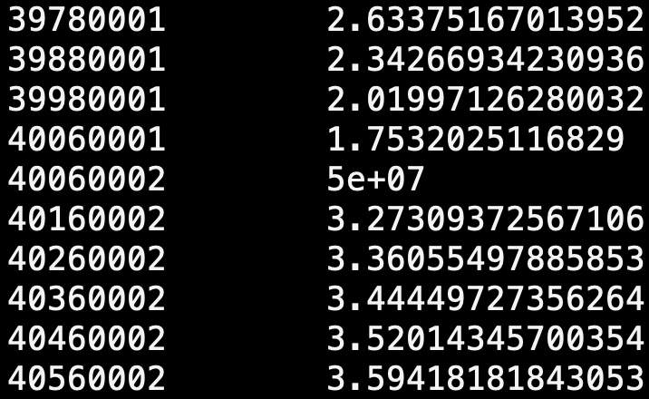
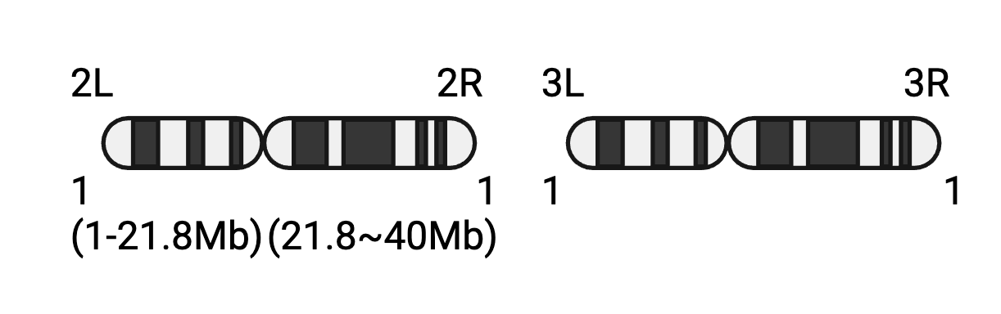
Simulation of multiple chromosomes in SLiM
SLiM doesn’t take the chromosome ID into consideration
Adjust the position based on the chromosome
Introduce 1bp with free recombination(0.5) between chromosome
cM/Mb
In SLiM

Slide 14
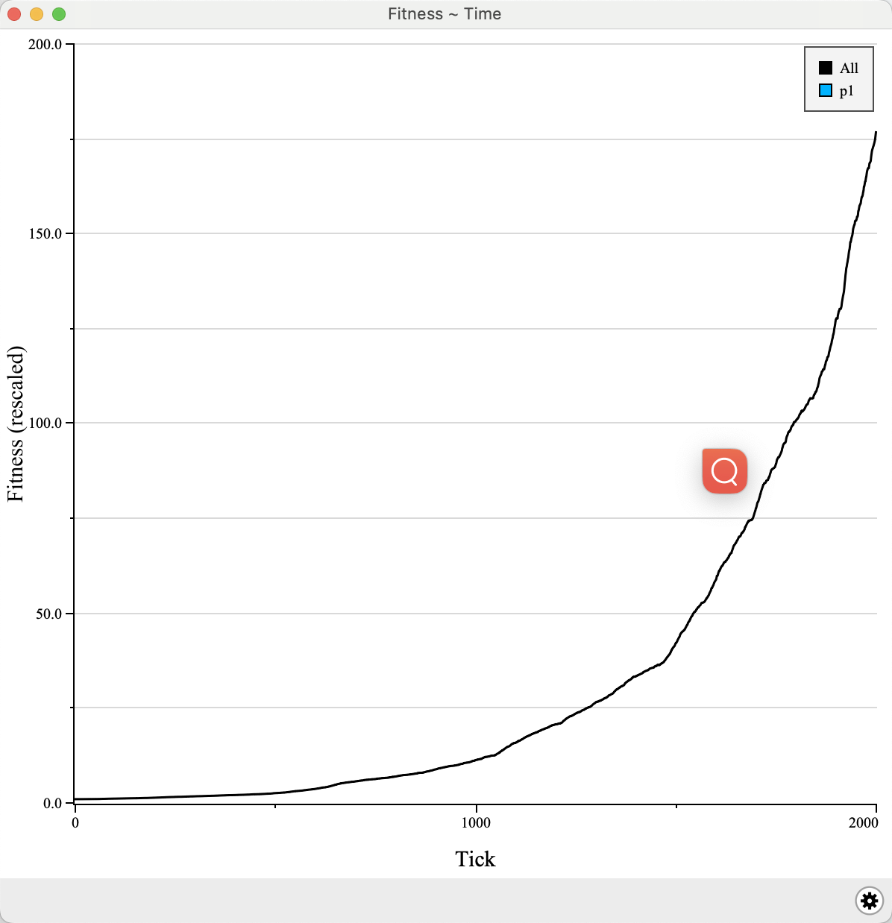
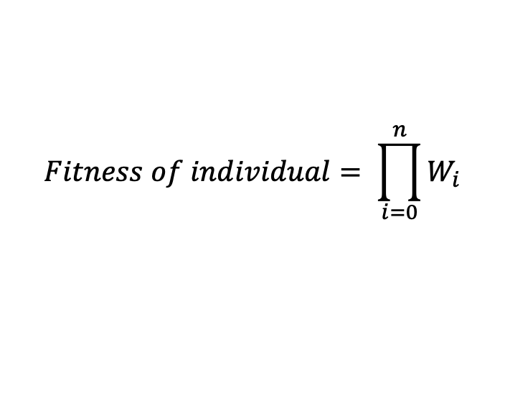
Selective sweep
Each locus is assigned with selection coefficients (s). Allele with higher s result to higher fitness additive effect (h=0.5) w = individual fitness
WAA=1+s
WAa=1+0.5*s
Waa=1
h=0.5
S=0.2
S=-0.1
A
B
$$Fitness of individual= \prod_{i=0}^{n}{W_{i}}$$
B
W_{Aa}=1+0.5*0.2=1.1
W_{BB}=1+(-0.1)=0.9
W=W_{Aa}*W_{BB}=0.99
*n represent number of loci of that individual
Notes:
Graphic showing the fitness

Slide 15
Model I: selective sweep + LE
Census population of 1250
60 generations
Selective sweep
Free recombination(r=0.5)
Each segregating is inherited independently
slim -d "rep=1" 01sweep_le.slim
Notes:
LD and LE

Slide 16
Model II: selective sweep + LD
Census population of 1250
60 generations
Selective sweep
Recombination map of D. simulans (materials/rec_map_slim.txt)
slim -d "rep=1" 02sweep_ld.slim

Slide 17
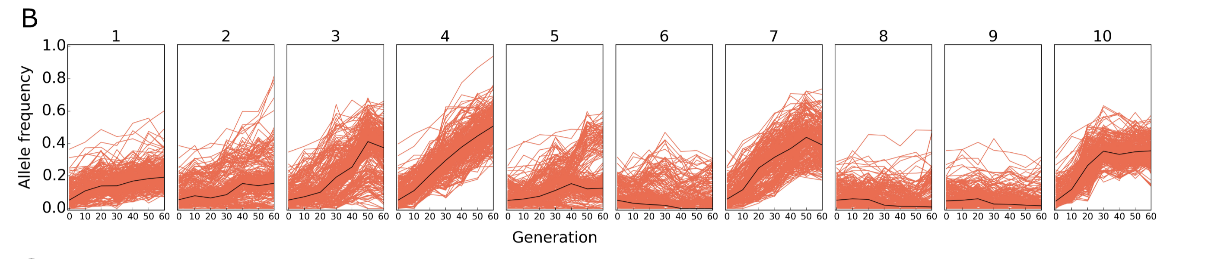
Model III: redundancy
(Barghi et al, 2019)
Census population of 1250
60 generations
Selective sweep
Recombination map of D. simulans (materials/rec_map_slim.txt)
Random subset of contributing loci respond to selection
slim -d "rep=1" -d "num_mut=40" 03redundancy.slim

Slide 18
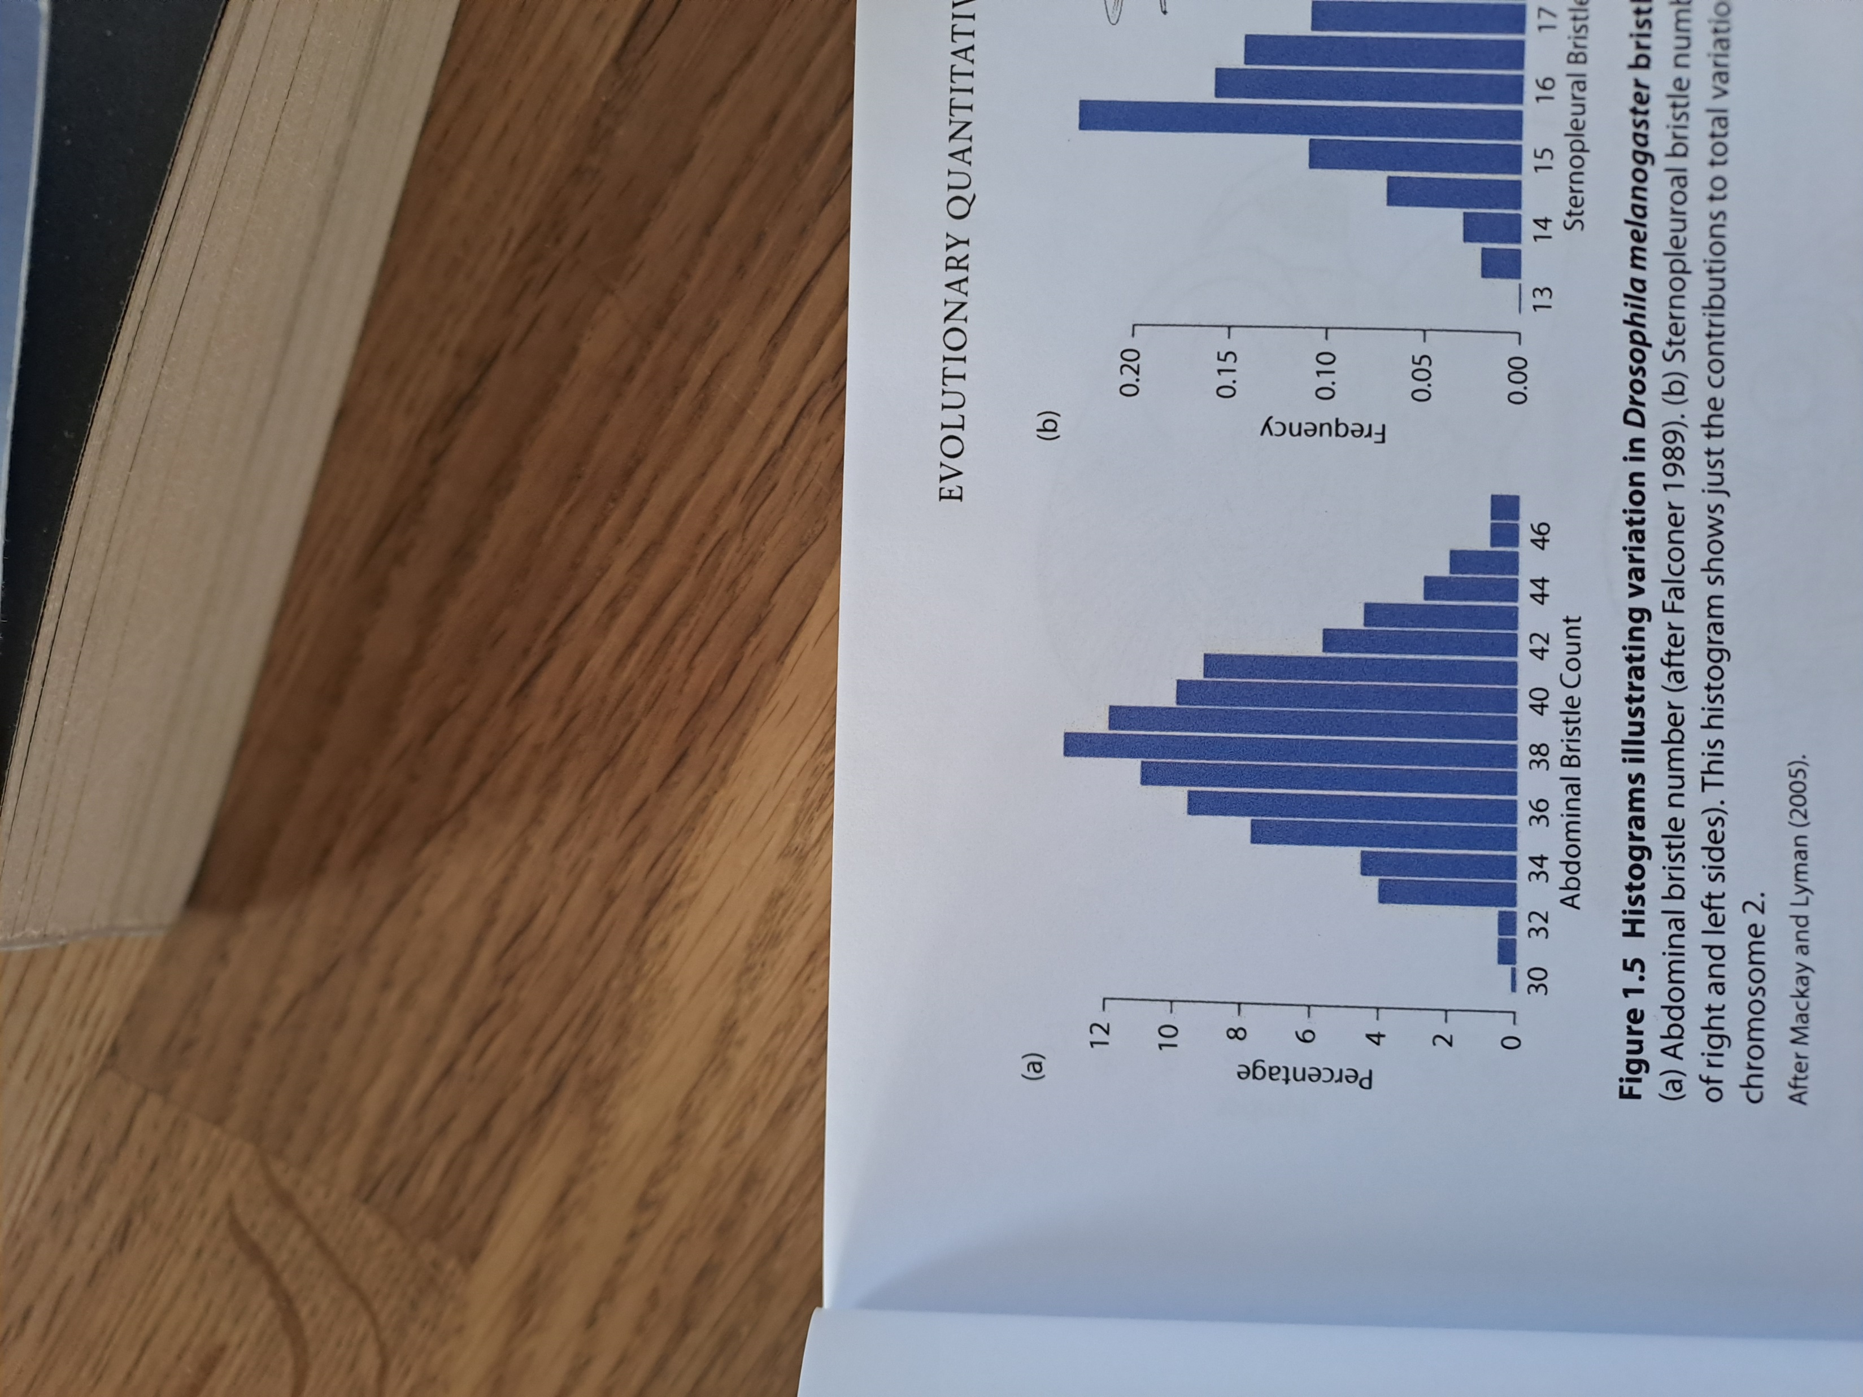
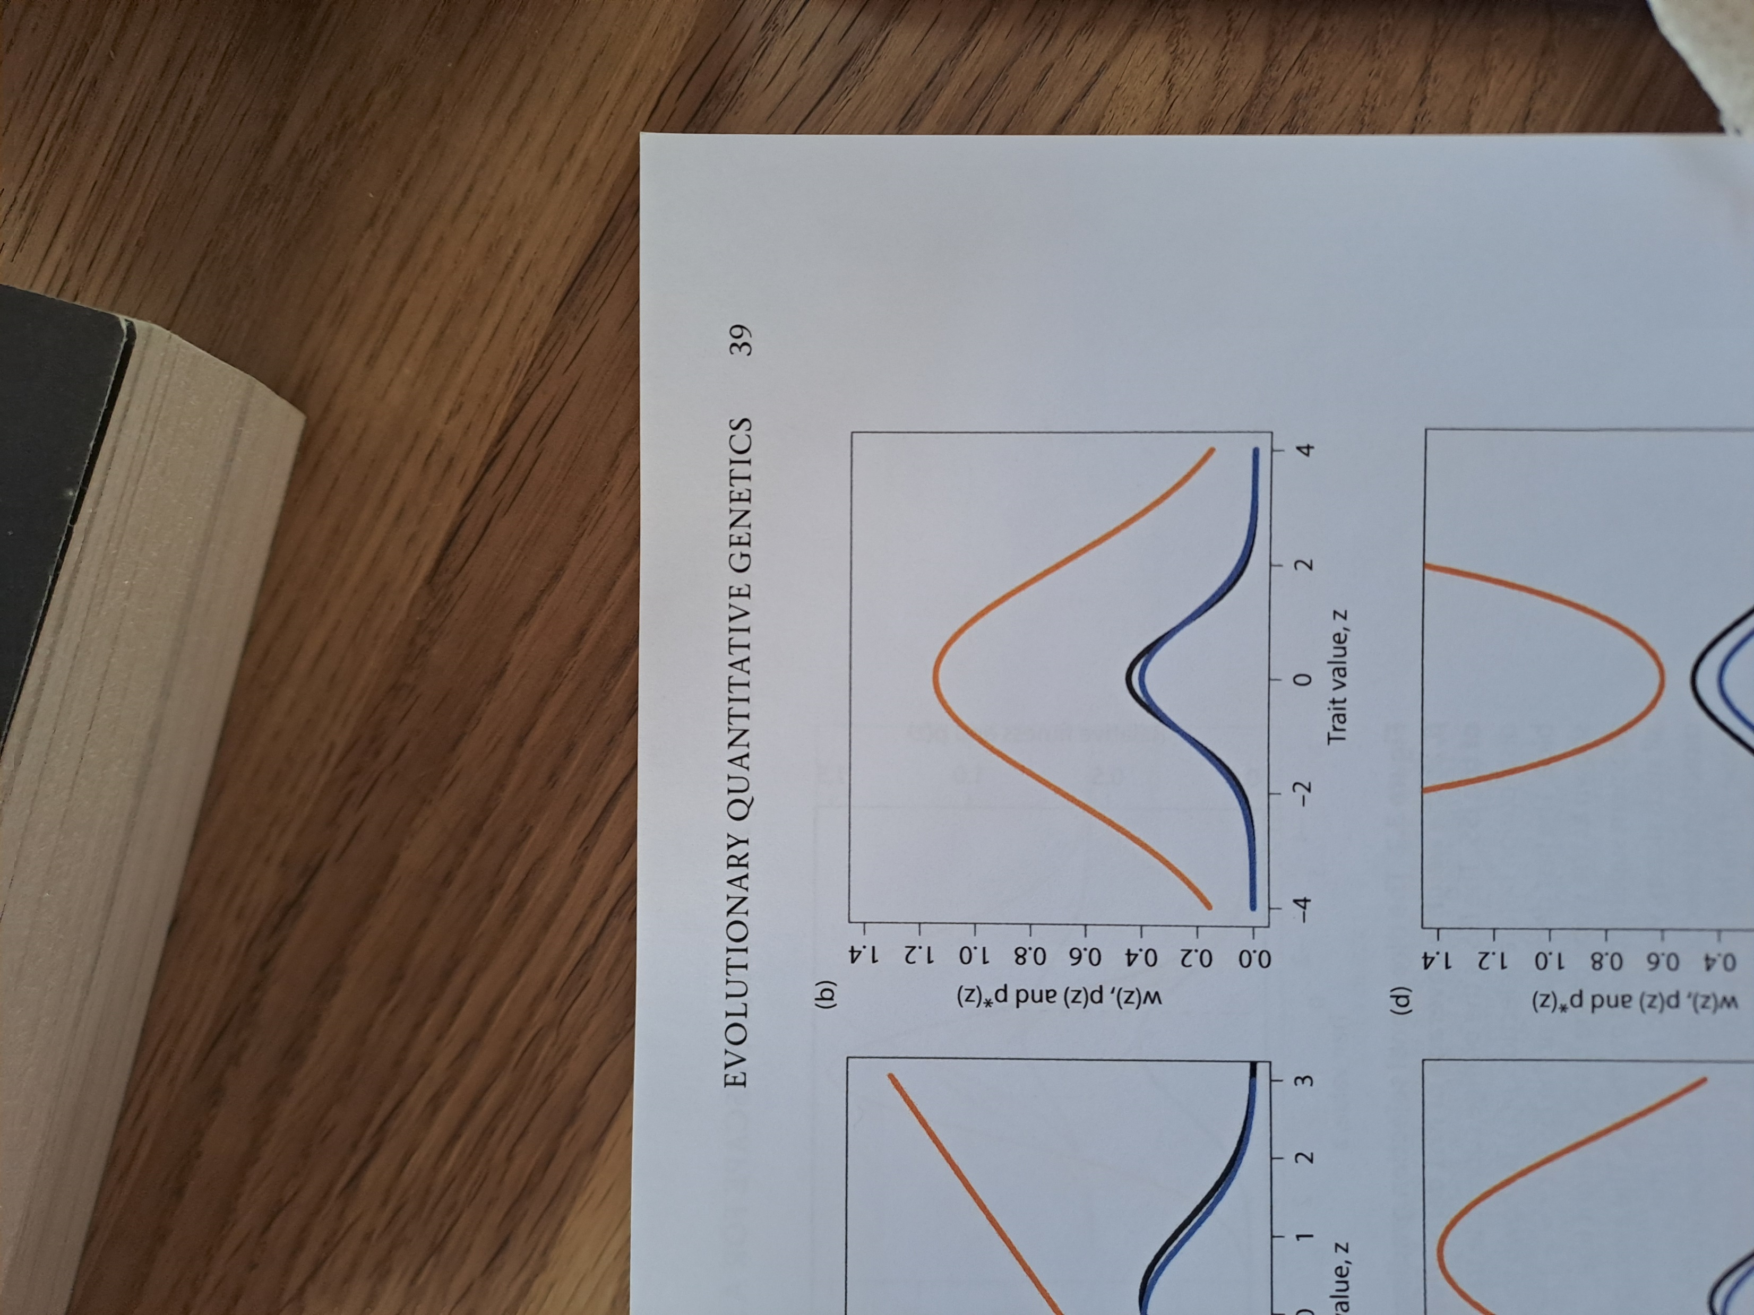
Quantitative traits under stabilizing selection
Arnold 2023, Evolutionary quantitative genetics
Notes:
Most important traits show continuous distribution within populations rather than a few, so that the resulting distribution is continuous and often unimodal (Wright 1968). The selection surface that causes such a trait distribution is suggested to be stabilizing selection which encourages the mean to reside on a specific value, known as the trait optimum. This selection surface is known as the fitness function which maps fitness to the phenotype.
------------------------------------------
Trait distribution before selection: p(z)
Trait distribution after selection: p*(z)
Individual selection surface or fitness function, relative fitness of individuals of phenotype z as a function of trait value:W(z)

Slide 19
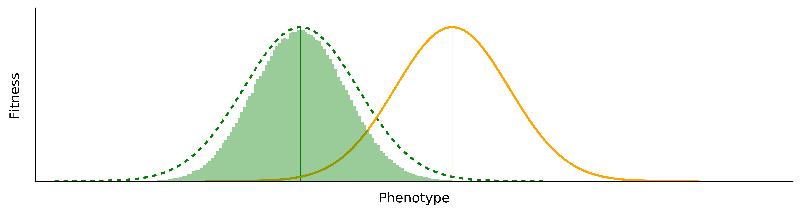
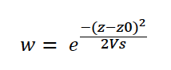
Adaptation of a quantitative trait after a shift in trait optimum
Current optimum
New optimum
Fitness
Trait
Fitness
Variance of fitness function
Notes:
Consider a population that after an environmental change experiences a novel selection pressure on a trait with a polygenic basis that is under stabilizing selection. This selection changes the optimal value of the trait. The population responds by a rapid shift of the trait mean towards the new optimum. But what is the genetic basis of this phenotypic change?

Slide 20
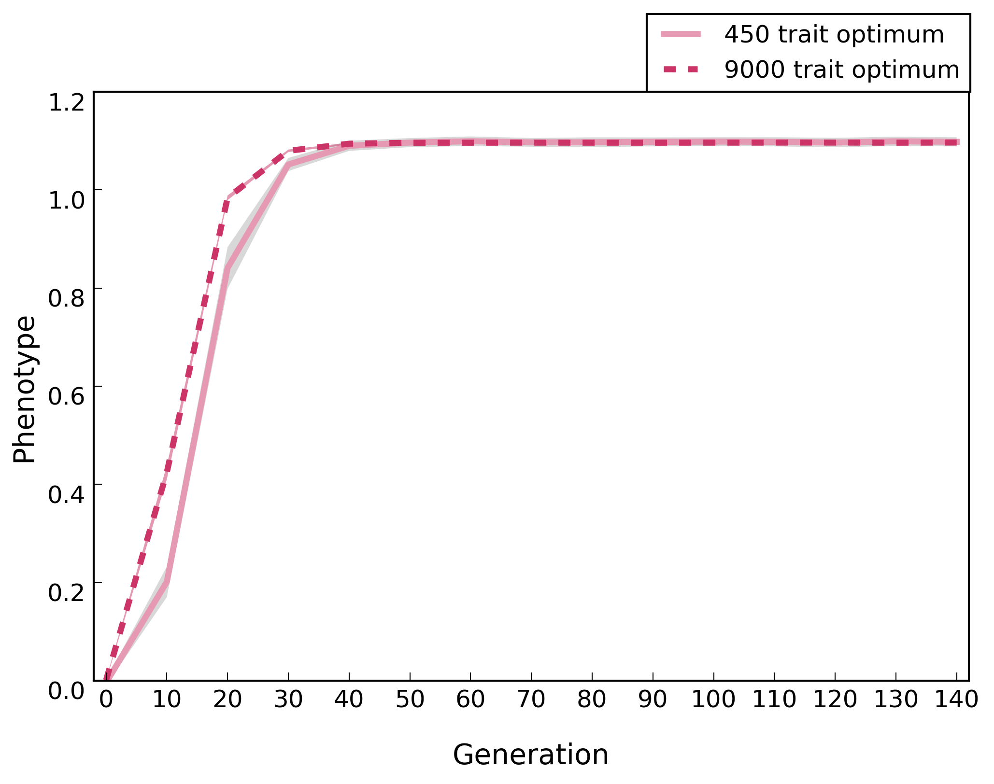
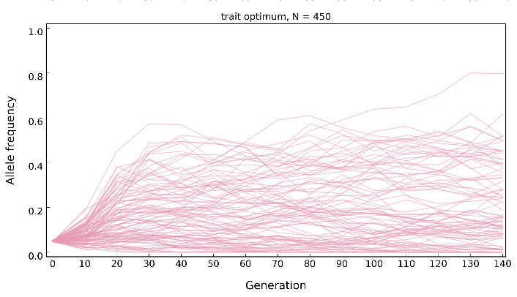
Patterns of phenotypic/genomic change during polygenic adaptation
Rapid/deterministic
Stabilizing/ Stochastic
Barghi and Schlötterer, 2020, GBE
Notes:
Theoretical models of polygenic adaptation (Hayward & Sella, 2022; Thornton, 2019) and simulations (Barghi & Schlötterer, 2020a; Franssen et al., 2017) predict that after a shift in the trait optimum, initially the population’s mean phenotype approaches the new optimum rapidly. But the phenotypic change slows down to a pause when the population’s mean phenotype nears the optimum. This lack of directional change in the population’s mean phenotype over time, i.e. phenotypic stasis, is typically associated with stabilizing selection in the absence of opposing fluctuating selection (Charlesworth et al., 1982; Stroud et al., 2023). Similarly, the frequency of beneficial alleles change until the new trait optimum is reached. Afterwards, there will be a stochastic phase (selection against the segregation load) where beneficial alleles are fixed or lost.
So, adaptation of a quantitative trait has different stages. Right after a shift in trait optimum, in the first stage where selection is directional, the trait mean adapts rapidly to match the new optimum. Starting from stage 2, the mean phenotype doesn’t change and selection is mostly stabilizing. Initially allele frequencies plateau and later alleles get fixed or lost.

Slide 21
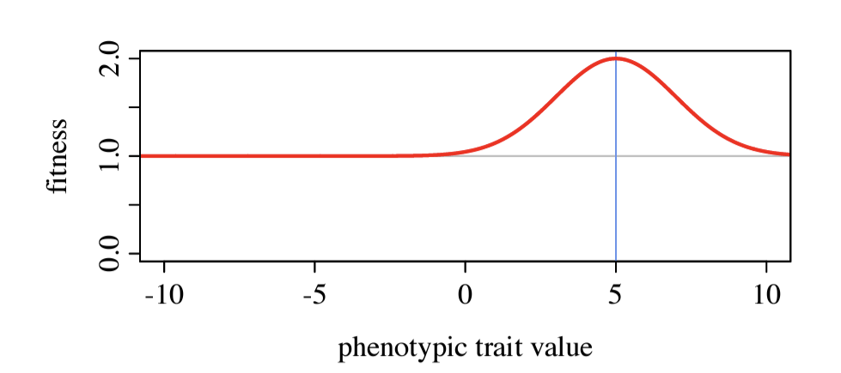
Stabilizing Selection
Multi-loci
single population
Instead, we:
Calculate the phenotype of an individual
Acquire the fitness distribution in the population
Selection act on phenotype through the fitness function, ultimately changing the genotypes.
Peak of fitness when phenotype = 5 (a hypothetical situation)

Slide 22
Model IV: QTL + LE
Census population of 1250
60 generations
Stabilizing selection
Free recombination
slim -d "rep=1" 04qtl_le.slim

Slide 23
Model V: QTL + LD
Census population of 1250
60 generations
Stabilizing selection
Recombination map of D. simulans (materials/rec_map_slim.txt)
slim -d "rep=1" 05qtl_ld.slim

Slide 24
External resources
SLiM Homepage:
https://messerlab.org/slim/
SLiM Manual:
https://github.com/MesserLab/SLiM/releases/download/v4.0.1/SLiM_Manual.pdf
SLiM workshop material:
http://benhaller.com/workshops/workshops.html
Recipe inside SLiM GUI

Slide 25
Overview
Day1
Detecting selection target
Reconstruct haplotype blocks
Day 2
SLiM simulation
Model Fitting
Drift
statistical methods
(CMH-test
Chisq-test)
Linkage (correlated frequency change)
characterize selection (e.g. selection coefficient)
Model selection
connection between simulation and experiments
summary statistics (e.g. Jaccard index)
Notes:
1.1 detecting selection target
-understand drift, effective population size and how they influence selection
-statical method detecting loci underlying selection based on the allele frequency change
1.2 reconstruct haplotype blocks
-understand linkage
-based on the correlation in allele frequency change between SNPs
-characterize selection at the haplotype scale(allele frequency change trajectories)
2.1 SLiM simulation
-learn two major selection process
-define selection model in SLiM
2.2 model fitting
-connection between simulation and empirical data
-exemplified summary statistics to measure the model fitting

Slide 26
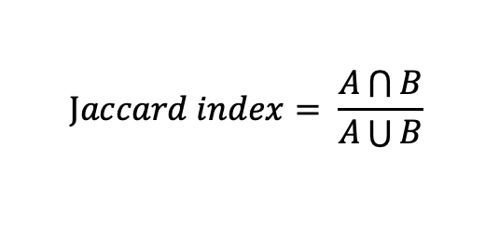
Bridging the empirical and simulation
Which models fits the empirical data best?
Jaccard index between biological replicates
Measurement of parallelism
$$Jaccard index= \frac{A\bigcap{B}}{A\bigcup{B}}$$
Detect SNPs responding to selection in each replicate
e.g. allele frequency larger than 0.1
Estimate Jaccard index between replicates within each model
Compare the Jaccard index between models

Slide 27
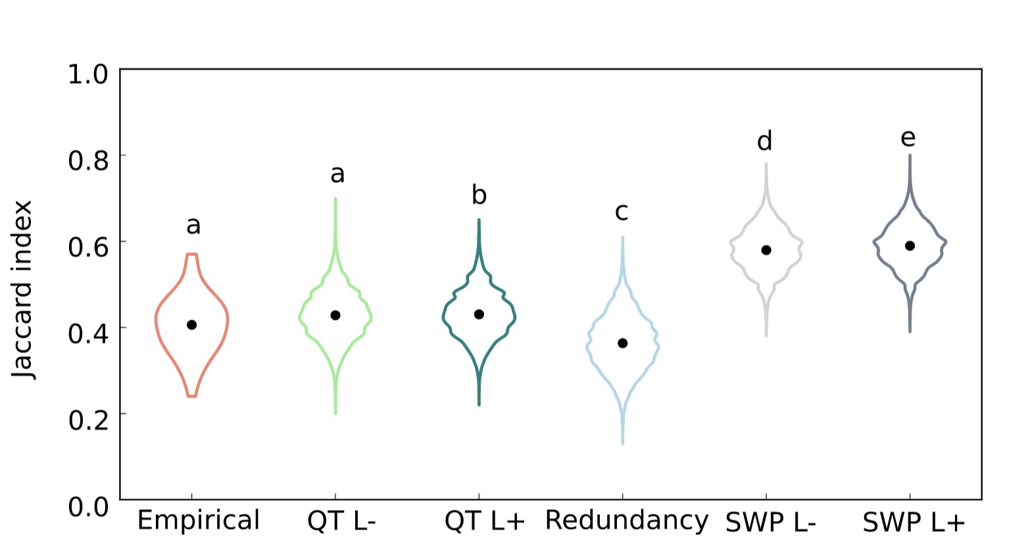
Jaccard index

Slide 28
Hope you had fun!
Any questions?

Slide 29
Natural Selection
Selection acts on phenotypes, mostly not on a single locus:
✓ Certain genotype with higher fecundity is fitter than ones with lower fecundity
✗ AA on rs12345678 is fitter than Aa
Combining all loci together => phenotype of an individual
Quantitative models of selection:
Fitness functions that define the relationship between phenotype and fitness:
Directional selection
Diversifying selection
Stabilizing selection

Slide 30
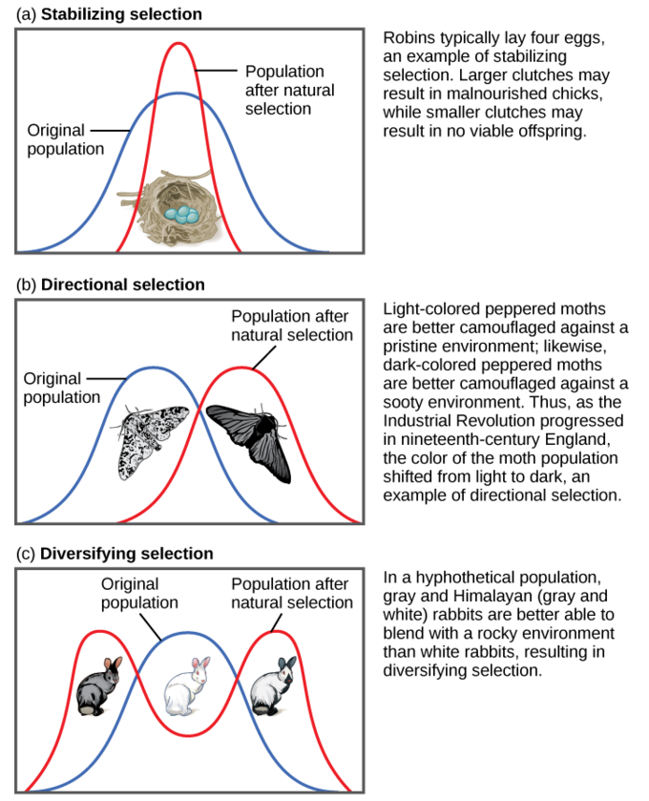
Natural Selection

Slide 31
Second Task
Simulate Directional Selection

Slide 32
Stabilizing Selection
Stabilizing_selection.slim
Multi-loci
single population
15% of mutation are beneficial while the others are neutral.
Instead, we:
Calculate the phenotype of an individual
Acquire the fitness distribution in the population
Selection act on phenotype through the fitness function, ultimately changing the genotypes.
Peak of fitness when phenotype = 5 (a hypothetical situation)

Slide 33
Stabilizing Selection
Exercises:
Plot the Fitness ~ Time trajectories in SLiM
What is different from the directional selection?
Plot subpopulation fitness distribution, did they stop at some point? How many m2 type mutation is in the population reached in the trait optimum?
Play around with the effect size of m2, population size and scaling

Slide 34
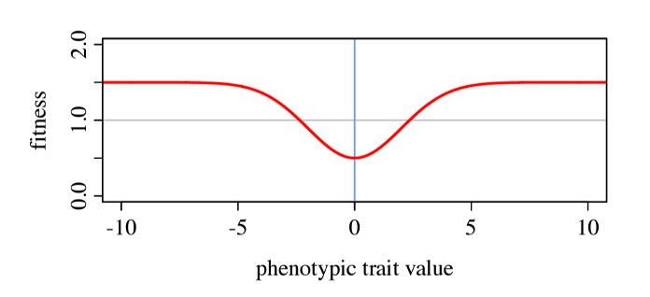
Diversifying Selection
scale = dnorm(0.0, 0.0, 2.0);
inds.fitnessScaling = 1.0 - dnorm(phenotypes, 0.0, 2.0) / scale;

Slide 35
Fourth Task
Simulation at the command line

Slide 36
Working on the terminal
Complex simulation take time and memory
Running multiple simulations in parallel
Flexible in parsing parameters
Run the slim in the terminal
Save the desired information into separate files
frequency
Phenotypes
Fitness
Seed…
Exercise
Have a look of Stabilizing_selection_cmd.slim
Run the simulation in the terminal
slim -s 4 -d ss=0.02 -d N=100 -d trait_mean=5.0 –d trait_var=2.0 Stabilizing_selection_cmd.slim

